Slide 1

Does Company Culture Increase Shareholder Value?
Analyzing Stock Performance of Glassdoor’s
“Best Places to Work” Companies
Michael Cho
October 2019

Slide 2
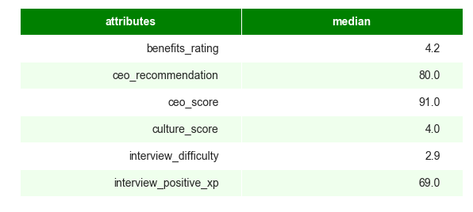
Median Attributes of “Best Places to Work” Companies
Great Benefits
Great CEO
Great Culture
Difficult but Positive Interview Experience
If your company fall within the follow attributes,
it is comparable to Glassdoor’s Best Places to Work!

Slide 3
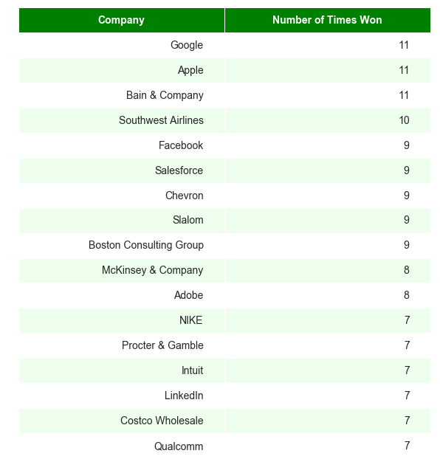
Companies that repeatedly win “Best Places to Work”
Google, Apple, and Bain & Co. have won every year since 2009

Slide 4
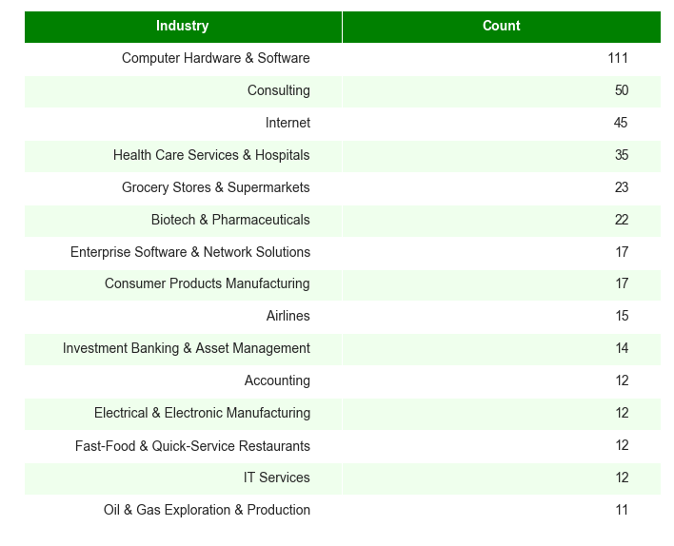
Industries that repeatedly win “Best Places to Work”
Technology & Consulting
are some of the best industries to work for.

Slide 5
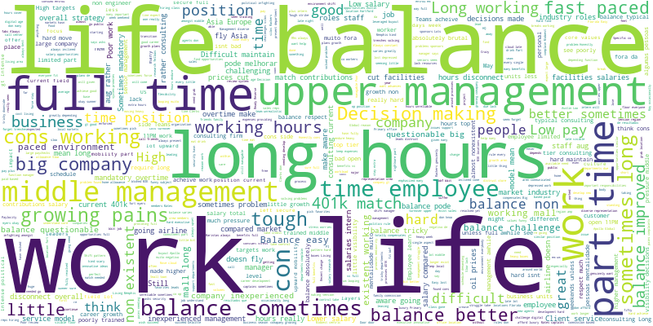
Negative Reviews from Employees at Best Places to Work
“Work Life Balance” is a reoccurring theme in both positive and negative reviews.
Bad Benefits, Management, Low Pay, Long Hours

Slide 6
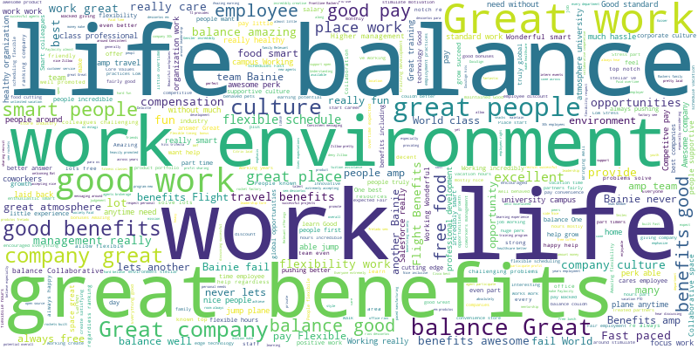
Positive Reviews from Employees at Best Places to Work
“Work Life Balance” is a reoccurring theme in both positive and negative reviews.
Great Benefits, Smart People, Flexible, Amazing Balance

Slide 7
Average 1-year return: Glassdoor vs. S&P 500 Companies
Average 1-year return
Glassdoor
19.1%
S&P 500
12.3%
*Dec 2008 – Oct 2019 Annualized Returns

Slide 8
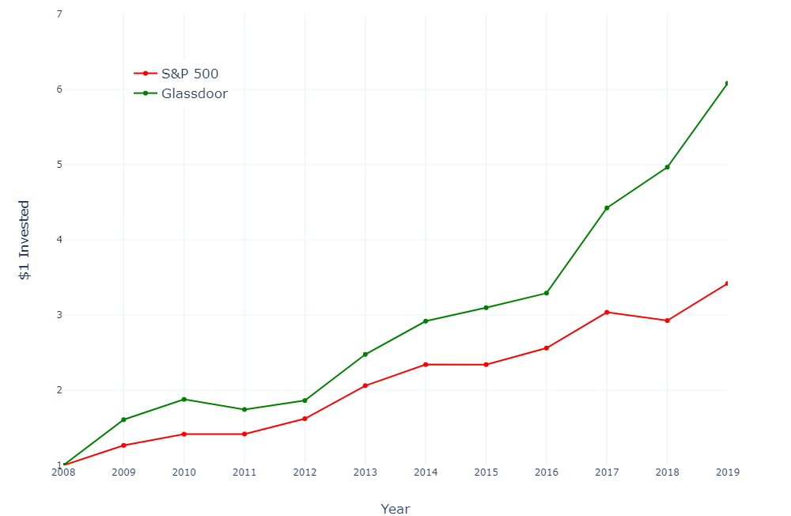
$1 invested in Glassdoor 'Best Places to Work' vs. S&P 500 Companies
6.1x
3.4x

Slide 9
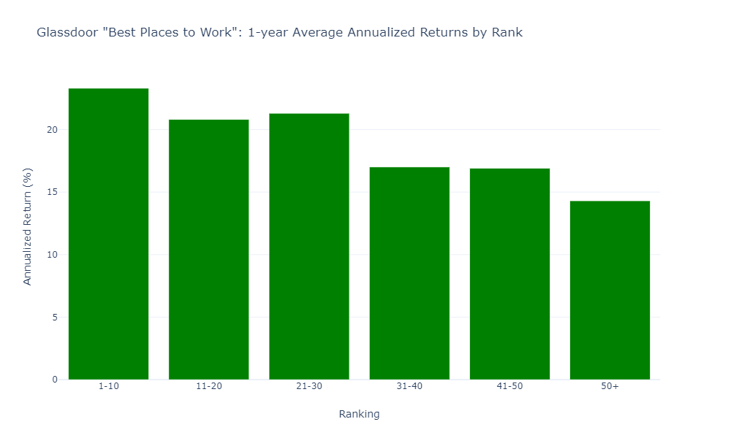
Higher Ranking, Higher Returns
Higher Ranking Companies may have better returns than lower ranking companies.
23.3%
21.3%
20.8%
17.0%
16.9%
14.3%
Rank Category is negatively correlated to one-year returns.
(Pearson Correlation: -0.96)

Slide 10
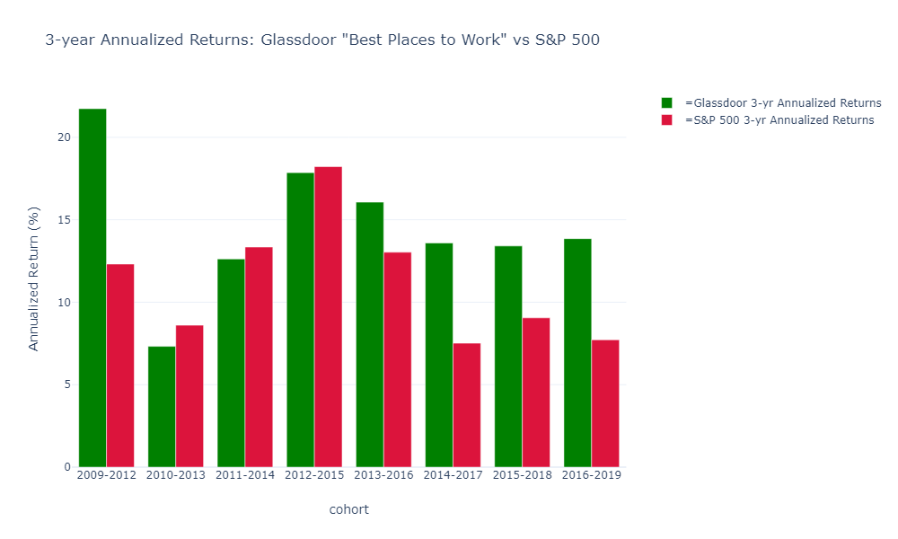
Buy and Hold “Best Places to Work” for 3 years
Average 3-year return
Glassdoor
15.7%
S&P 500
11.2%
*Dec 2008 – Dec 2018 Annualized Returns

Slide 11
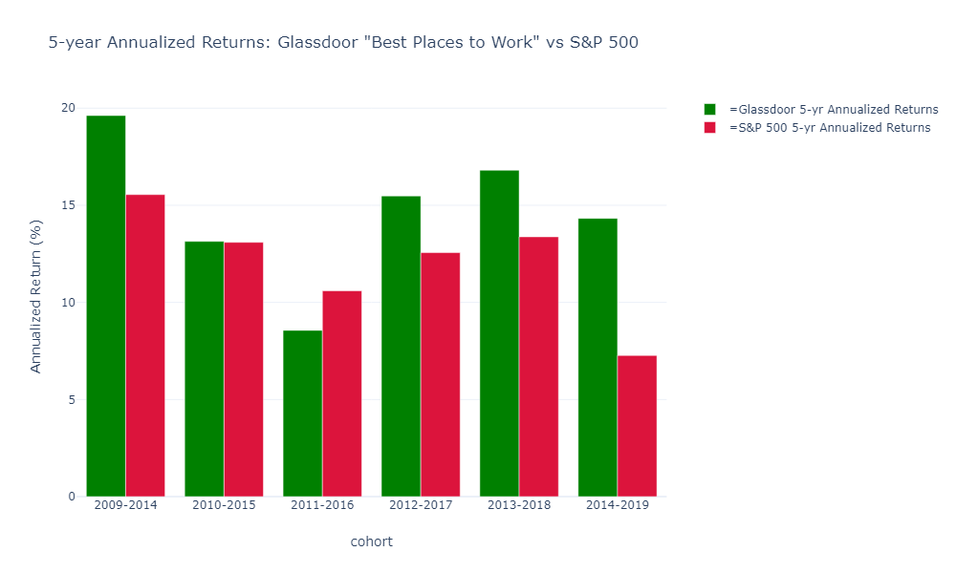
Buy and Hold “Best Places to Work” for 5 years
Average 5-year return
Glassdoor
15.3%
S&P 500
12.1%
*Dec 2008 – Dec 2018 Annualized Returns

Slide 12
Conclusion
Company Culture is not short-term catalyst
but a long-term competitive advantage.
Shareholders: Invest in companies with good culture.
Companies: Invest in and around your employees.
Unemployed: Look for great culture, benefits &
‘Work – Life – Balance’

